Slide 1
AutoBot Bargainer
Group Members:
Lawrence Wanderi Mwangi (100836815)
Tejas Devani (100846988)
Smriti Raina (100830255)
Vaibhavi Thakkar (100833169)
Shrutika Raut (100844617)

Slide 2
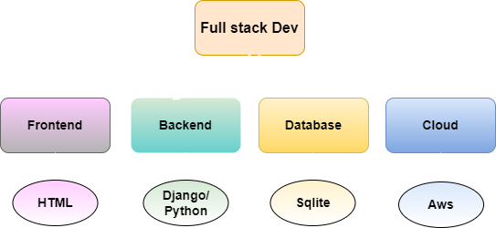
Objective
Objective & Scope
Technology Stack
AutoBot Bargainer provides innovative and automated system that helps customer to buy second-hand cars at best deal.
A web-based software powered with AI that allows customer to browse the second-hand cars and bargain with the chatbot for the flexible price.

Slide 3
Chatbot Flow
Web UI
AI Agent
Car
Listing Page
Chat
Make an offer
User
Car
Details Page
Offer Accepted
No
Accept Deal
Negotiate
Price
Yes
Checkout
Exit

